Slide 1
Regression Analysis
Analysis of Variance
Nicoleta Serban, Ph.D.
Professor
School of Industrial and Systems Engineering
Mean Pairwise Comparison

Slide 2

About This Lesson

Slide 3
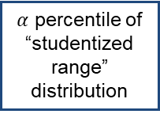
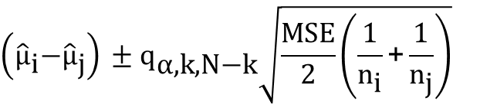
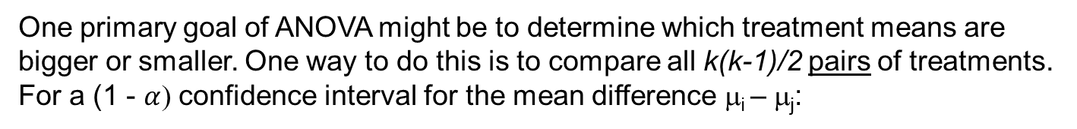
Pairwise Comparison of Means
One primary goal of ANOVA might be to determine which treatment means are bigger or smaller. One way to do this is to compare all k(k-1)/2 pairs of treatments. For a (1 - $α$) confidence interval for the mean difference μ_{i} – μ_{j}:
$$\left({\hat{\text{μ}}}_{\text{i}}\text{−}{\hat{\text{μ}}}_{\text{j}}\right) \text{±} {\text{q}}_{\text{α}\text{,}\text{k}\text{,}\text{N}\text{−}\text{k}}\sqrt{\frac{\text{MSE}}{\text{2}}\left(\frac{\text{1}}{{\text{n}}_{\text{i}}}\text{+}\frac{\text{1}}{{\text{n}}_{\text{j}}}\right)}$$
Estimate of difference in means
$α$ percentile of “studentized range” distribution
Standard deviation/error of estimator

Slide 4
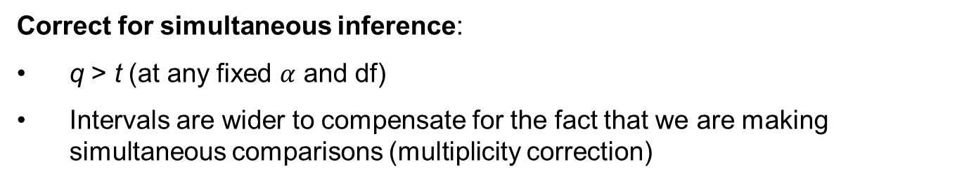

Difference Between t$\text{α}$and q$\text{α}$
Correct for simultaneous inference:
q > t (at any fixed $α$ and df)
Intervals are wider to compensate for the fact that we are making simultaneous comparisons (multiplicity correction)
Why?
95% CIs for two populations ⇒ (.95)(.95) ≈ .90 ⇒ The simultaneous or joint confidence level for the two parameters is roughly 90%.
95% CIs for three populations ⇒ (.95)(.95)(.95) ≈ .86 ⇒ The simultaneous or joint confidence level for the three parameters is roughly 86%.

Slide 5

Example1: Global Suicide by Region
Which country regions have different suicide rates?

Slide 6
Pairwise Comparison
TukeyHSD(aov(suicidesper100k ~ region, data=suicide_data))
Tukey multiple comparisons of means
95% family-wise confidence level
$region
diff lwr upr p adj
EASTERN EUROPE-ASIA 7.1256986 -0.8654681 15.1168654 0.1218931
GLOBAL WEST-ASIA 1.3948384 -6.3253621 9.1150390 0.9998655
LATIN AMER. & CARIB-ASIA -2.4242761 -9.7079484 4.8593961 0.9848625
MIDDLE EAST-ASIA -7.8183246 -17.4646356 1.8279865 0.2171605
NORTHERN AMERICA-ASIA 1.8826591 -18.6470201 22.4123382 0.9999996
OCEANIA-ASIA -0.6423728 -13.5277421 12.2429965 1.0000000
SUB-SAHARAN AFRICA-ASIA -4.2457218 -17.1310911 8.6396474 0.9858800
WESTERN ASIA-ASIA -9.6996143 -30.2292935 10.8300649 0.8717761
WESTERN EUROPE-ASIA 2.4643324 -10.4210369 15.3497016 0.9997844
GLOBAL WEST-EASTERN EUROPE -5.7308602 -12.5740866 1.1123662 0.1809537
LATIN AMER. & CARIB-EASTERN EUROPE -9.5499748 -15.8966379 -3.2033117 0.0002123
MIDDLE EAST-EASTERN EUROPE -14.9440232 -23.9039098 -5.9841367 0.000026
……..

Slide 7
Pairwise Comparison
10 different categories, total of 45 different pairwise comparisons
Two groups with only one observation and three groups with three observations – not sufficient data for comparison
Only three pairs have an adjusted p-value smaller than 0.05: Latin America vs Eastern Europe, Middle East vs Eastern Europe and Middle East vs Global West
TukeyHSD(aov(suicidesper100k ~ region, data=suicide_data))
Tukey multiple comparisons of means
95% family-wise confidence level
$region
diff lwr upr p adj
EASTERN EUROPE-ASIA 7.1256986 -0.8654681 15.1168654 0.1218931
GLOBAL WEST-ASIA 1.3948384 -6.3253621 9.1150390 0.9998655
LATIN AMER. & CARIB-ASIA -2.4242761 -9.7079484 4.8593961 0.9848625
MIDDLE EAST-ASIA -7.8183246 -17.4646356 1.8279865 0.2171605
NORTHERN AMERICA-ASIA 1.8826591 -18.6470201 22.4123382 0.9999996
OCEANIA-ASIA -0.6423728 -13.5277421 12.2429965 1.0000000
SUB-SAHARAN AFRICA-ASIA -4.2457218 -17.1310911 8.6396474 0.9858800
WESTERN ASIA-ASIA -9.6996143 -30.2292935 10.8300649 0.8717761
WESTERN EUROPE-ASIA 2.4643324 -10.4210369 15.3497016 0.9997844
GLOBAL WEST-EASTERN EUROPE -5.7308602 -12.5740866 1.1123662 0.1809537
LATIN AMER. & CARIB-EASTERN EUROPE -9.5499748 -15.8966379 -3.2033117 0.0002123
MIDDLE EAST-EASTERN EUROPE -14.9440232 -23.9039098 -5.9841367 0.000026
……..

Slide 8

ANOVA Example 2: Keyboard Layout
Three different keyboard layouts are being compared in terms of typing speed.
Layout 1 Layout 2 Layout 3
23.8 30.2 27.0
25.6 29.9 25.4
24.0 29.1 25.6
25.1 28.8 24.2
25.5 29.1 24.8
26.1 28.6 24.0
23.8 28.3 25.5
25.7 28.7 23.9
24.3 27.9 22.6
26.0 30.5 26.0
24.6 * 23.4
27.0 * *
Which mean typing times for the three keyboard layouts are different?

Slide 9
Pairwise Comparison
TukeyHSD(aov(speed ~ layout))
Tukey multiple comparisons of means
95% family-wise confidence level
Fit: aov(formula = speed ~ layout)
$layout
diff lwr upr p adj
2-1 3.9850000 2.854395 5.1156053 0.0000000
3-1 -0.3613636 -1.463581 0.7408538 0.7008915
3-2 -4.3463636 -5.500092 -3.1926352 0.0000000
Keyboard layout 2 has a statistically significantly higher typing time than keyboard layouts 1 and 3, on average.
It is plausible that keyboard layouts 1 and 3 have similar typing time, on average.

Slide 10

Summary

